Slide 1


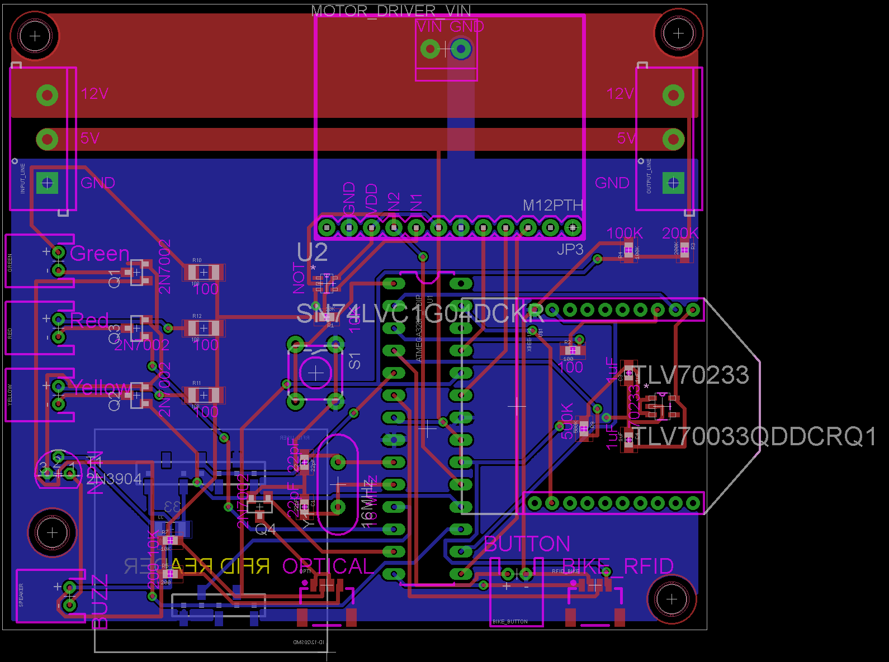
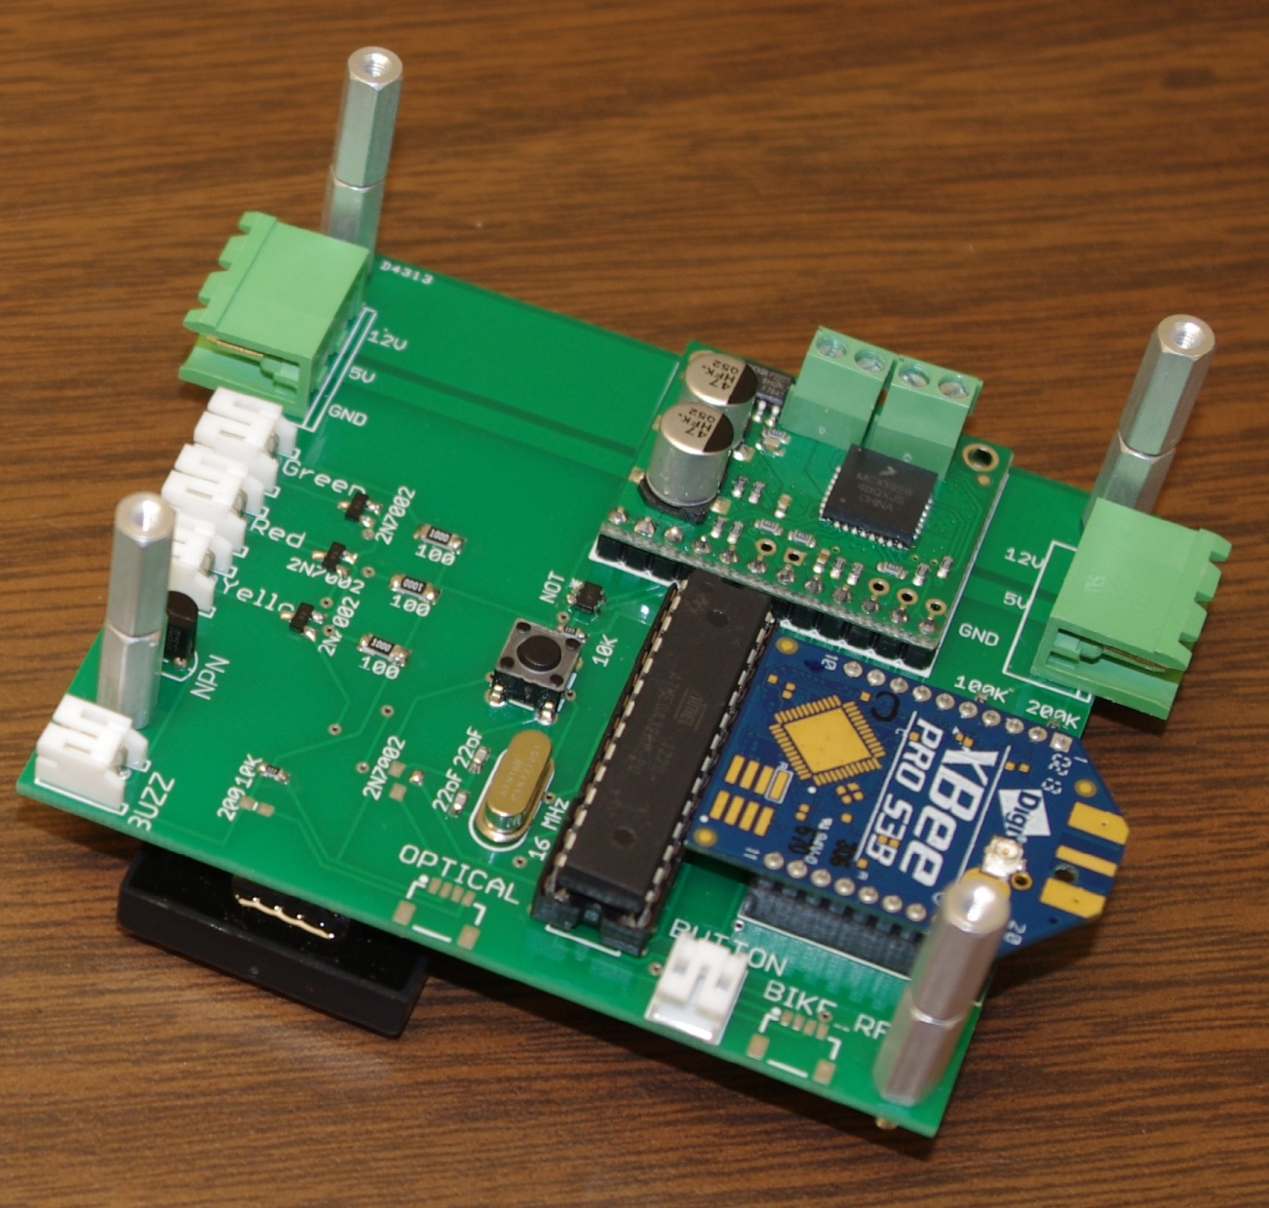
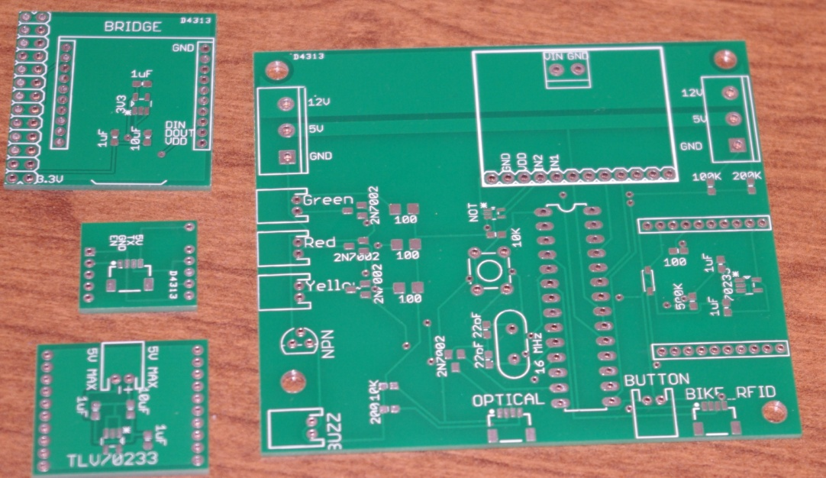
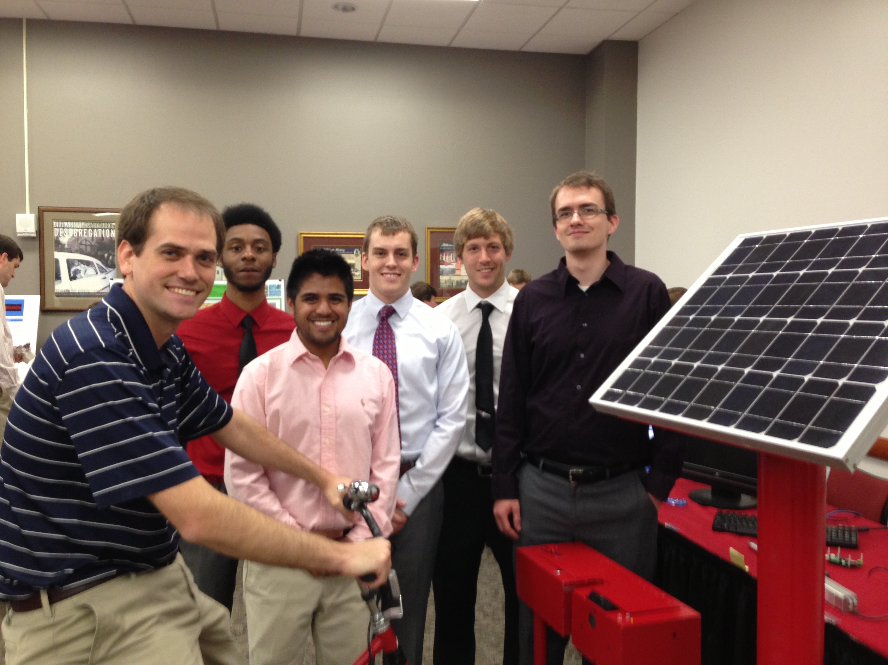
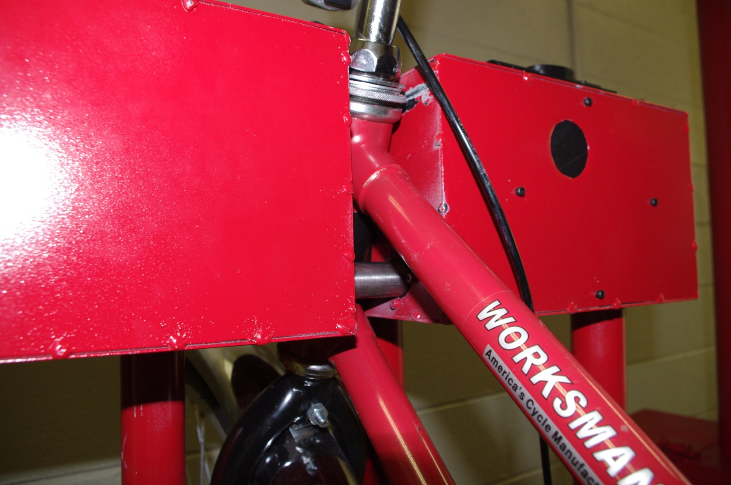
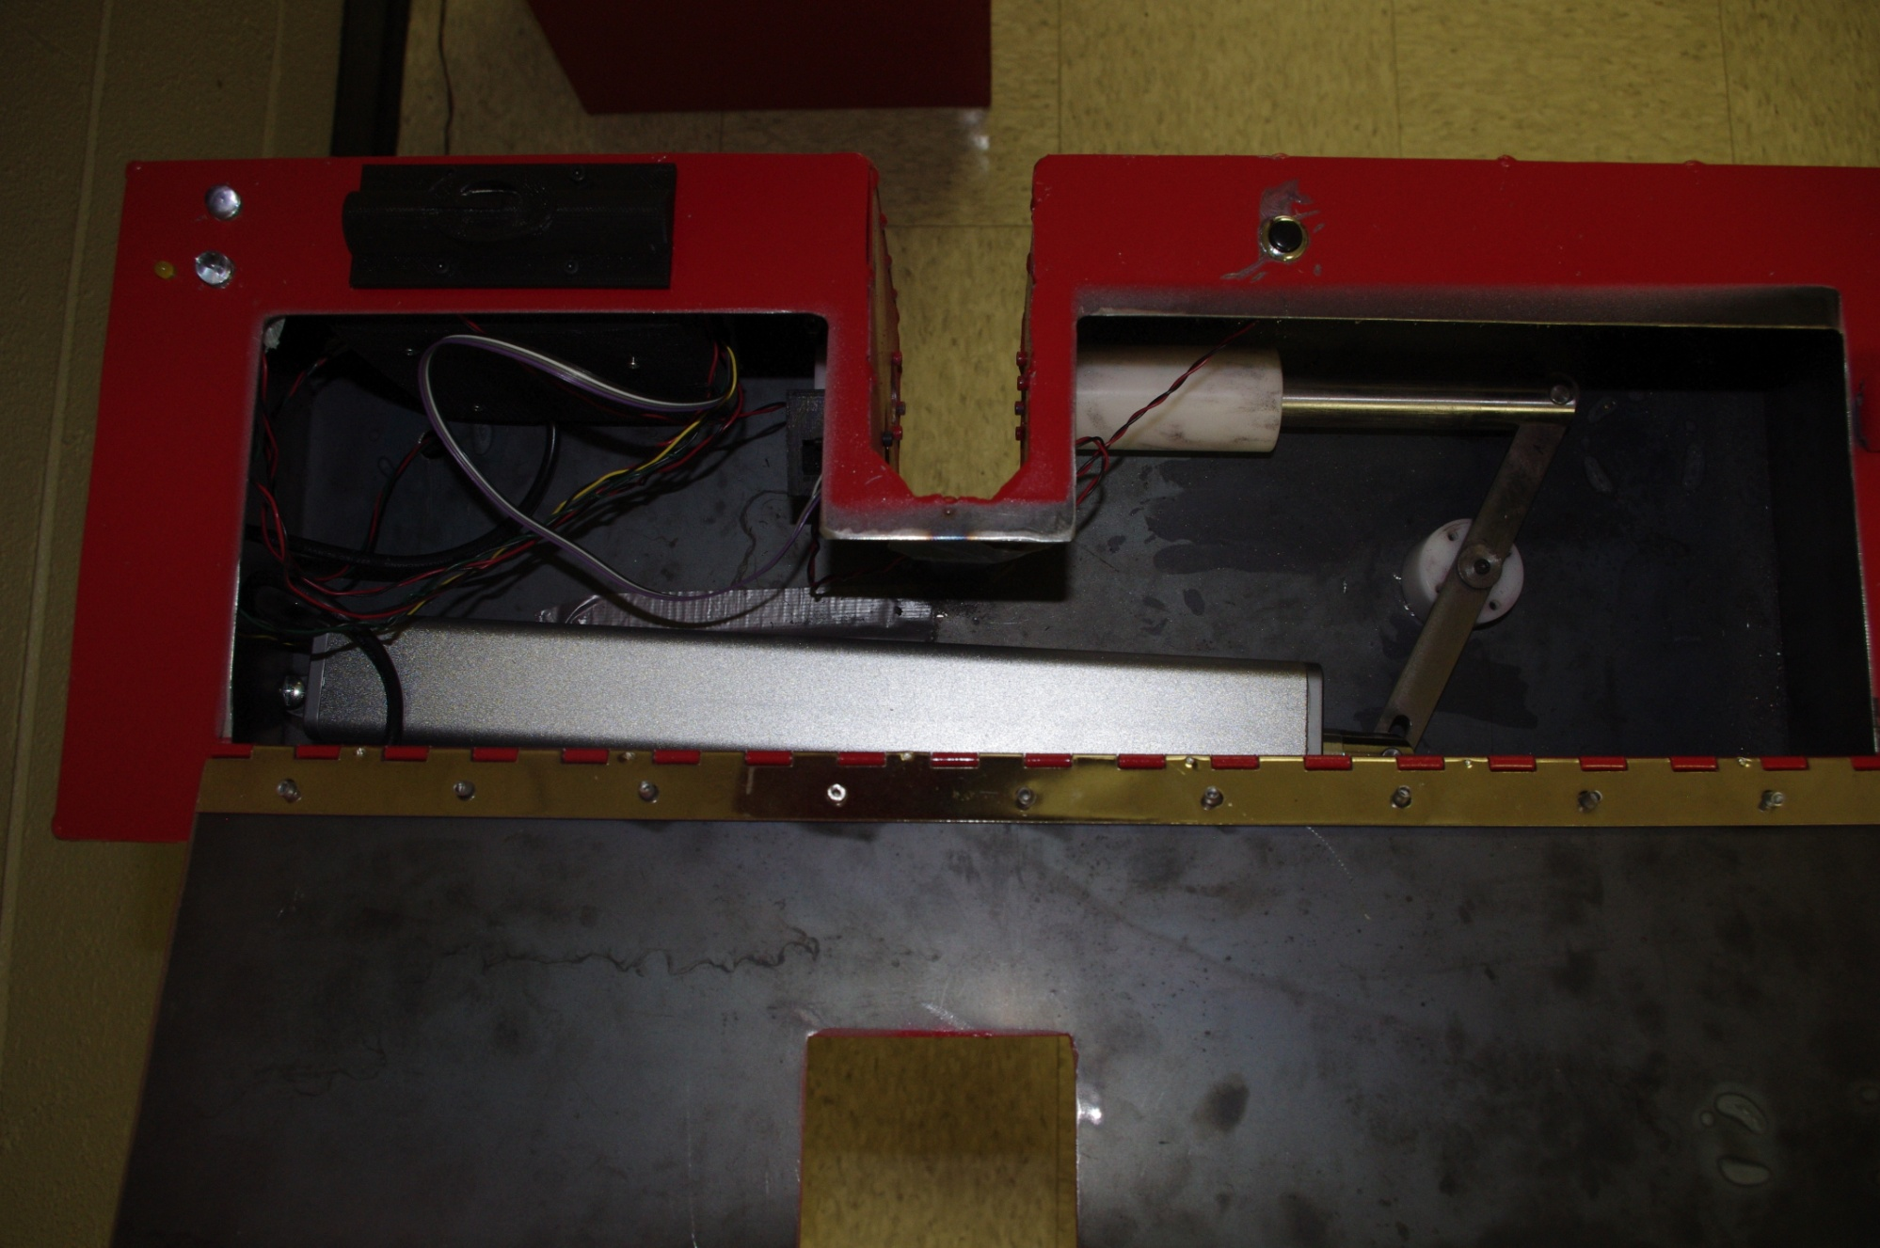
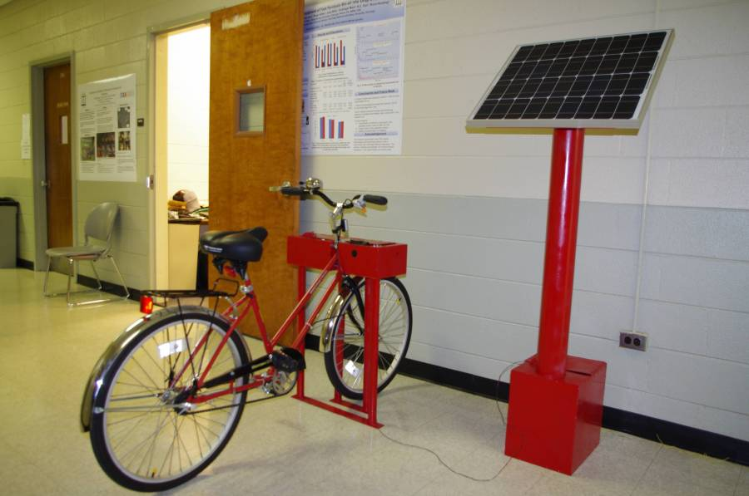
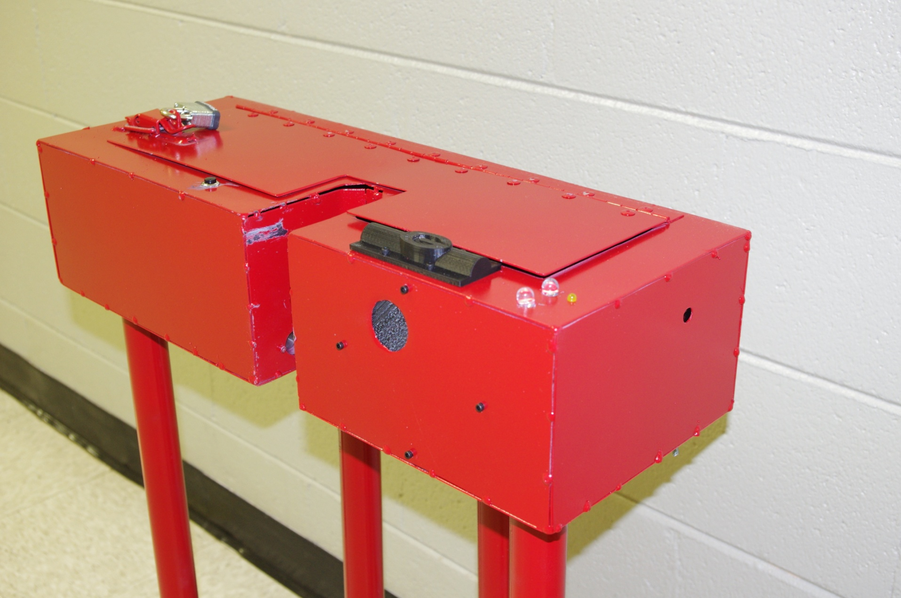
Robotic Doorman Project
Team: Adam Hall, Jasper Yu, Peter Wins
Mentors: Dr. Kyle Johnsen, Dr. Peter Kner
Driftmier Engineering Center, Athens, GA 30602
Problem Statement
Design Overview
Conclusion & Future Work
Our group has been tasked with creating an automated classroom access solution to augment existing access solutions in the form of an inexpensive retrofit rather than an expensive overhaul. Current access solutions for students, faculty, and staff, such as providing keys to students, or swiping a magnetic stripe or RFID card, are a hassle at best and insecure at worse. (More stuff here.)
The goal of this project is to design and manufacture an automated access system which will strike a balance between convenience, security, and accountability for UGA students, faculty, and the University system.
Computer Engineering Design:
The bike station electronics were designed to provide ease of use for the users . The electronics allow for the stations to be placed in a variety of locations across campus. The stations are capable of talking to the server to keep track of checkout information and verify bike locks.
After research and testing, a working prototype of the station, dock, bridge, and database was successfully built. Each component of the system was able to communicate with each other in order to lock or unlock a bike, as long as there was a valid bike and valid user RFID. The project is completely scalable because more docks could be added to our station and more stations could be added to the network.
Future work would consist of better hardware and software security, corrections and improvements to the PCB design, and the hardware being used. The current security does not take into account the power being turned off, if the lid to access the PCB board is open or not, or if the online forms and websites are hacked.
The Team
Cost Analysis
Mechanical Engineering Design:
Mechanical design focused on ensuring that once the bike was locked, no one would be able to remove it. Simplicity was kept in mind to reduce the amount of parts needed; which also reduces the number of failure points. All parts were drawn and assembled using AutoCAD to ensure proper sizing. Strength calculations were performed to ensure the system met all the design needs.
From left to right: Kyle Johnsen, Eric Refour, Oscar Garduno,
Nathaniel Wood, Nathan Kelley, and Colby Sweet
Acknowledgements
This project was funded by the UGA Office of Sustainability.
1180 E Broad St Athens, GA 30602
(706) 542-1301
Also, special thanks to:
Kareem Mahmoud (customer) for bringing this project to the Engineering Center.
Thanks to Terry Walsh for manufacturing the final prototype.
Dr. Johnsen and Dr. Kner for their invaluable help.

